Slide 1
Chapter 4
The Simplex Algorithm
to accompany
Operations Research: Applications and Algorithms
4th edition
by Wayne L. Winston
Copyright (c) 2004 Brooks/Cole, a division of Thomson Learning, Inc.

Slide 2
4.1 How to Convert an LP to Standard Form
Before the simplex algorithm can be used to solve an LP, the LP must be converted into a problem where all the constraints are equations and all variables are nonnegative.
An LP in this form is said to be in standard form.

Slide 3
Example 1: Leather Limited
Leather Limited manufactures two types of leather belts: the deluxe model and the regular model.
  Each type requires 1 square yard of leather.
  A regular belt requires 1 hour of skilled labor and a deluxe belt requires 2 hours of skilled labor.
  Each week, 40 square yards of leather and 60 hours of skilled labor are available.
  Each regular belt contributes $3 profit and each deluxe belt $4.
Write an LP to maximize profit.

Slide 4
To convert a ≤ constraint to an equality, define for each constraint a slack variable s_{i} (s_{i} = slack variable for the ith constraint).
A slack variable is the amount of the resource unused in the ith constraint.
If a constraint i of an LP is a ≤ constraint, convert it to an equality constraint by adding a slack variable s_{i} to the ith constraint and adding the sign restriction s_{i} ≥ 0.

Slide 5

Note that LP 1’ is in standard form.
In summary, if constraint i of an LP is a ≤ constraint, then we convert it to an equality constraint by adding a slack variable si to the ith constraint and adding the sign restriction si≥ 0.

Slide 6
To convert the ith ≥ constraint to an equality constraint, define an excess variable (sometimes called a surplus variable) e_{i} (e_{i} will always be the excess variable for the ith ≥ constraint.
  We define e_{i} to be the amount by which ith constraint is over satisfied.
Subtracting the excess variable e_{i} from the ith constraint and adding the sign restriction e_{i} ≥ 0 will convert the constraint.

Slide 7
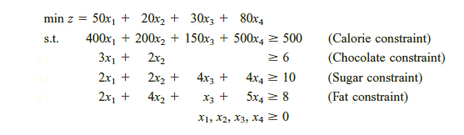
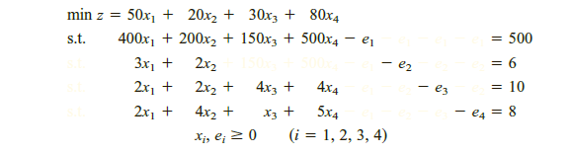
General form ;
Standard Form;

Slide 8
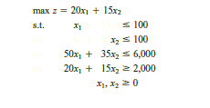
If an LP has both ≤ and ≥ constraints, then simply apply the procedures described to the individual constraints.
Example;
  Convert the following LP to standard form.

Slide 9
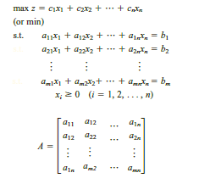
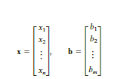
4.2 Preview of the Simplex Algorithm
Suppose we have converted an LP with m constraints into standard form.
Assuming that the standard form contains n variables (labeled for convenience x1, x2, . . . , xn), the standard form for such an LP is
the constraints for the model may be written as the system of equations Ax = b.

Slide 10
Consider a system Ax = b of m linear equations in n variables (where n ≥ m).
A basic solution to Ax = b is obtained by setting n – m variables equal to 0 and solving for the remaining m variables.
  This assumes that setting the n – m variables equal to 0 yields a unique value for the remaining m variables, or equivalently, the columns for the remaining m variables are linearly independent.
Any basic solution in which all variables are nonnegative is called a basic feasible solution (or bfs).
To find a basic solution to Ax= b, we choose a set of n - m variables (the nonbasic variables, or NBV) and set each of these variables equal to 0.
Then we solve for the values of the remaining n- (n- m) = m variables (the basic variables, or BV) that satisfy Ax= b.

Slide 11

Of course, the different choices of nonbasic variables will lead to different basic solutions.
To illustrate, we find all the basic solutions to the following system of two equations in three variables:

Slide 12

Some sets of m variables do not yield a basic solution. For example, consider the following linear system:
If NBV={x₃} then BV={x₁,x₂}
No basic solution!!! WHY???

Slide 13
The following theorems explain why the concept of a basic feasible solution is of great importance in linear programming.
  Theorem 1 The feasible region for any linear programming problem is a convex set. Also, if an LP has an optimal solution, there must be an extreme point of the feasible region that is optimal.

Slide 14
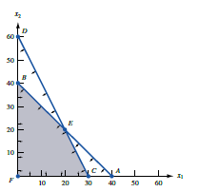

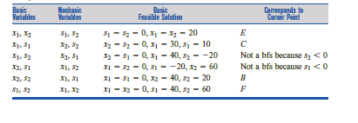
Consider the following LP;

Slide 15
Degeneracy
Note that more than one set of basic variables may correspond to a given extreme point. If this is the case, then we say the LP is degenerate.

Slide 16
4.3 Direction of Unboundedness
Consider an LP in standard form with feasible region S and constraints Ax=b and x ≥ 0. Assuming that our LP has n variables, 0 represents an n-dimensional column vector consisting of all 0’s.
A non-zero vector d is a direction of unboundedness if for all x∈S and any c≥0, x +cd∈S

Slide 17
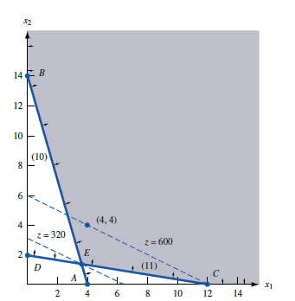
If we are in the LP’s feasible region, then we can move as far as we want in the direction d and remain in the feasible region.

Slide 18
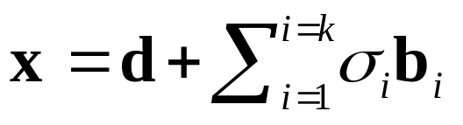

Theorem 2 Consider an LP in standard form, having bfs b₁, b₂,…b_{k}. Any point x in the LP’s feasible region may be written in the form
where d is 0 or a direction of unboundedness and =1 and σ_{i} ≥ 0.
Any feasible x may be written as a convex combination of the LP’s bfs.

Slide 19
Adjacent Basic Feasible Solutions
Before describing the simplex algorithm in general terms, we need to define the concept
of an adjacent basic feasible solution.
For any LP with m constraints, two basic feasible solutions are said to be adjacent if their sets of basic variables have m- 1 basic variables in common.

Slide 20
A general description of how the simplex algorithm solves LPs in a max problem.
Step 1 Find a bfs to the LP. We call this bfs the initial basic feasible solution. In general, the most recent bfs will be called the current bfs, so at the beginning of the problem the initial bfs is the current bfs.
Step 2 Determine if the current bfs is an optimal solution to the LP. If it is not, then find an adjacent bfs that has a larger z-value.
Step 3 Return to step 2, using the new bfs as the current bfs.

Slide 21
4.5 The Simplex Algorithm
The simplex algorithm can be used to solve LPs in which the goal is to maximize the objective function.
  Step 1 Convert the LP to standard form
  Step 2 Obtain a bfs (if possible) from the standard form
  Step 3 Determine whether the current bfs is optimal
  Step 4 If the current bfs is not optimal, determine which nonbasic variable should be come a basic variable and which basic variable should become a nonbasic variable to find a bfs with a better objective function value.
  Step 5 Use EROs to find a new bfs with a better objective function value. Go back to Step 3.

Slide 22
Example 2: Dakota Furniture Company
The Dakota Furniture company manufactures desk, tables, and chairs.
  The manufacture of each type of furniture requires lumber and two types of skilled labor: finishing and carpentry.
  The amount of each resource needed to make each type of furniture is given in the table below.
Resource | Desk | Table | Chair
Lumber | 8 board ft | 6 board ft | 1 board ft
Finishing hours | 4 hours | 2 hours | 1.5 hours
Carpentry hours | 2 hours | 1.5 hours | 0.5 hours

Slide 23
Ex. 2 - continued
At present, 48 board feet of lumber, 20 finishing hours, 8 carpentry hours are available. A desk sells for $60, a table for $30, and a chair for $ 20.
Dakota believes that demand for desks and chairs is unlimited, but at most 5 tables can be sold.
Since the available resources have already been purchased, Dakota wants to maximize total revenue.

Slide 24
Ex. 2: Solution continued
Begin the simplex algorithm by converting the constraints of the LP to the standard form.
Then convert the LP’s objective function to the row 0 format.
z -60x₁- 30x₂-20x₃= 0
To put the constraints in standard form, simply add slack variables s₁, s₂, s₃, s₄, respectively to the four constraints.
Label the constraints row 1, row 2, row 3, row 4, and add the sign restrictions s_{i} ≥ 0.

Slide 25
Ex. 2: Solution continued
Putting rows 1-4 together in row 0 and the sign restrictions yields these equations and basic variables.
 | Canonical Form 0 |  | Basic Variable
Row 0 | z – 60x₁ – 30x₂ – 20x₃ | = 0 | z = 0
Row 1 | 8x₁ + 6x₂ + x₃ + s₁ | = 48 | s₁ = 48
Row 2 | 4x₁ + 2x₂ + 1.5x₃ + s₂ | = 20 | s₂ = 20
Row 3 | 2x₁ + 1.5x₂ + 0.5x₃ + s₃ | = 8 | s₃ = 6
Row 4 | x₂ + s₄ | = 5 | s₄ = 5

Slide 26
Ex. 2: Solution continued
To perform the simplex algorithm, we need a basic (although not necessarily nonnegative) variable for row 0.
  Since z appears in row 0 with a coefficient of 1, and z does not appear in any other row, we use z as the basic variable.
  With this convention, the basic feasible solution for our initial canonical form has
    BV = {z, s₁, s₂, s₃, s₄}
    NBV = {x₁, x₂, x₃}.
  For this initial bfs, z=0, s₁=48, s₂= 20, s₃=8, s₄=5, x₁=x₂=x₃=0.
A slack variable can be used as a basic variable if the rhs of the constraint is nonnegative.

Slide 27
Ex. 2: Solution continued
Once we have obtained a bfs, we need to determine whether it is optimal.
To do this, we try to determine if there is any way z can be increased by increasing some nonbasic variable from its current value of zero while holding all other nonbasic variables at their current values of zero.
  Solving for z in row 0 yields: Z = 60x₁ + 30x₂ + 20x₃

Slide 28
Ex. 2: Solution continued
For each nonbasic variable, we can use this equation to determine if increasing a nonbasic variable will increase z.
  Increasing any of the nonbasic variables will cause an increase in z.
  However increasing x₁ causes the greatest rate of increase in z. If x₁ increases from its current value of zero, it will have to become a basic variable.
  For this reason, x₁ is called the entering variable. Observe x₁ has the most negative coefficient in row 0.

Slide 29
Ex. 2: Solution continued
Next choose the entering variable to be the nonbasic variable with the most negative coefficient in row 0.
Goal is to make x₁ as large as possible but as it increases, the current basic variables will change value. Thus, increasing x₁ may cause a basic variable to become negative.
This means to keep all the basic variables nonnegative, the largest we can make x₁ is min {6, 5, 4} = 4.

Slide 30
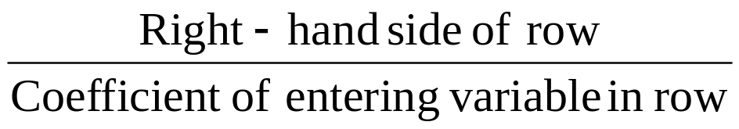
Ex. 2: Solution continued
Rule for determining how large an entering variable can be.
  When entering a variable into the basis, compute the ratio
  for every constraint in which the entering variable has a positive coefficient.
    The constraint with the smallest ratio is called the winner of the ratio test.
    The smallest ratio is the largest value of the entering variable that will keep all the current basic variables nonnegative.

Slide 31
Ex. 2: Solution continued
Always make the entering variable a basic variable in a row that wins the ratio test.
To make x₁ a basic variable in row 3, we use elementary row operations (EROs) to make x₁ have a coefficient of 1 in row 3 and a coefficient of 0 in all other rows.
  This procedure is called pivoting on row 3; and row 3 is called the pivot row.
  The final result is that x₁ replaces s₃ as the basic variable for row 3. The term in the pivot row that involves the entering basic variable is called the pivot term.

Slide 32
Ex. 2: Solution continued
The result is
The procedure used to go from one bfs to a better adjacent bfs is called an iteration of the simplex algorithm.
 | Canonical Form 1 |  | Basic Variable
Row 0 | z + 15x₂ - 5x₃ + 30s₃ | = 240 | z = 240
Row 1 | - x₃ + s₁ - 4s₃ | = 16 | s₁ = 16
Row 2 | - x₂ + 0.5 x₃ + s₂ - 2 s₃ | = 4 | s₂ = 4
Row 3 | x₁ + 0.75x₂ + 0.25x₃ + 0.5s₃ | = 4 | x₁ = 4
Row 4 | x₂ + s₄ | = 5 | s₄ = 5

Slide 33
Ex. 2: Solution continued
Attempt to determine if the current bfs is optimal.
Rearranging row 0 from Canonical Form 1, and solving for z yields
z = 240 – 15x₂ +5x₃ -30s₃
The current bfs is NOT optimal because increasing x₃ to 1 (while holding the other nonbasic variable to zero) will increase the value of z.
Making either x₂ or s₃ basic will cause the value of z to decrease.

Slide 34
Ex. 2: Solution continued
Recall the rule for determining the entering variable is the row 0 coefficient with the greatest negative value.
Since x₃ is the only variable with a negative coefficient, x₃ should be entered into the basis.
Performing the ratio test using x₃ as the entering variable yields the following results (holding other NBVs to zero):
    From row 1, s1 ≥ 0 for all values of x3 since s1 = 16 + x3
    From row 2, s2 ≥ 0 if x3 > 4 / 0.5 = 8
    From row 3, x1 ≥ 0 if x3 >4 / 0.25 = 16
    From row 4, s4 ≥ 0 for all values of x3 since s4 = 5

Slide 35
Ex. 2: Solution continued
This means to keep all the basic variables nonnegative, the largest we can make x₁ is min {8,16} = 8. So, row 2 becomes the pivot row.
The result of using EROs, to make x₃ a basic variable in row 2.
 | Canonical Form 2 |  | Basic Variable
Row 0 | z + 5x₂ + 10s₂ + 10s₃ | = 280 | z = 280
Row 1 | - 2x₂ + s₁ + 2s₂ - 8s₃ | = 24 | s₁ = 24
Row 2 | - 2x₂ + x₃ + 2s₂ - 4s₃ | = 8 | x₃ = 8
Row 3 | x₁ + 1.25x₂ - 0.5 s₂ + 1.5s₃ | = 2 | x₁ = 2
Row 4 | x₂ + s₄ | = 5 | s₄ = 5

Slide 36
Ex. 2: Solution continued
In Canonical Form 2
  BV = {z, s₁, x₃, x₁, s₄}
  NBV = {s₃, s₂, x₂ }
  Yielding the bfs z = 280, s₁=24, x₃=8, x₁=2, s₄=5, s₂=s₃=x₂=0
Solving for z in row 0 yields
z = 280 - 5x₂ - 10s₂ -10s₃
We can see that increasing x₂, s₂, or s₃ (while holding the other NBVs to zero) will cause the value of z to decrease.

Slide 37
Ex. 2: Solution continued
The solution at the end of iteration 2 is therefore optimal. The following rule can be applied to determine whether a canonical form’s bfs is optimal.
  A canonical form is optimal (for a max problem) if each nonbasic variable has a nonnegative coefficient in the canonical form’s row 0.

Slide 38
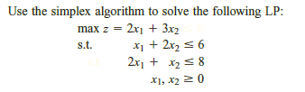
Example

